Slide 1
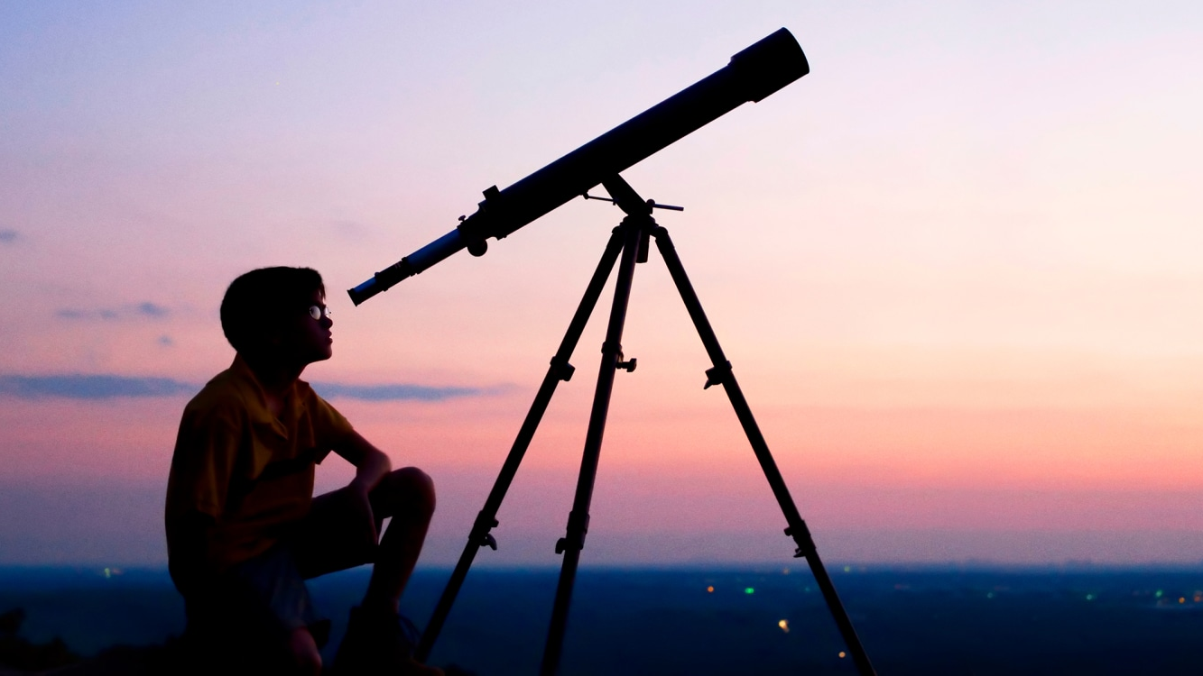
Bright Star
Telescopes made easy™
SWE 363 Project proposal for team 7

Slide 2
OUR SUCCESS TEAM
OMAR ALOMRAN, 202017840
Rayyan Alsuhaibani, 202029380
Osama Alibrahim, 202035080
Mohammed Alsedais , 202017760
Sohaib Aledlah, 202045260

Slide 3
Observing the hassles
Complicated governmental permissions
Intricate telescopes technicalities
Logistic challenges
LOW communication between interested individuals

Slide 4
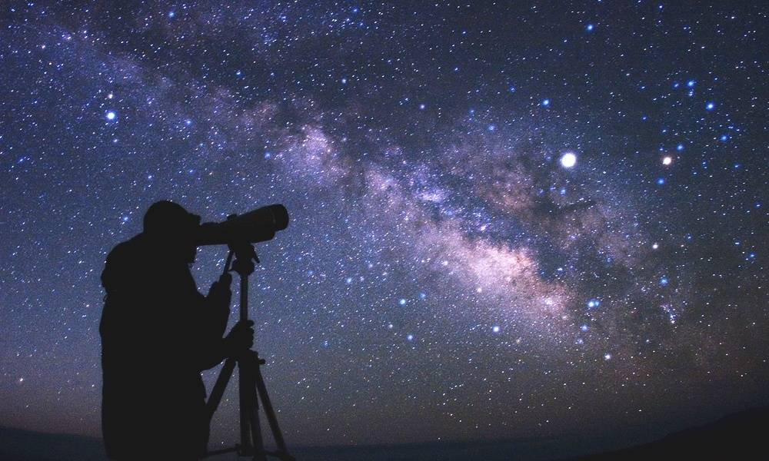
Bright Star™ with bright solutions!
Home delivered permission-acquired telescopes
Fitting bundles for different budgets
Encouraging communication between hobbyists

Slide 5

Why us?
Ready bundles
Trustworthy
Relief from government permission hassles
After-sale support

Slide 6

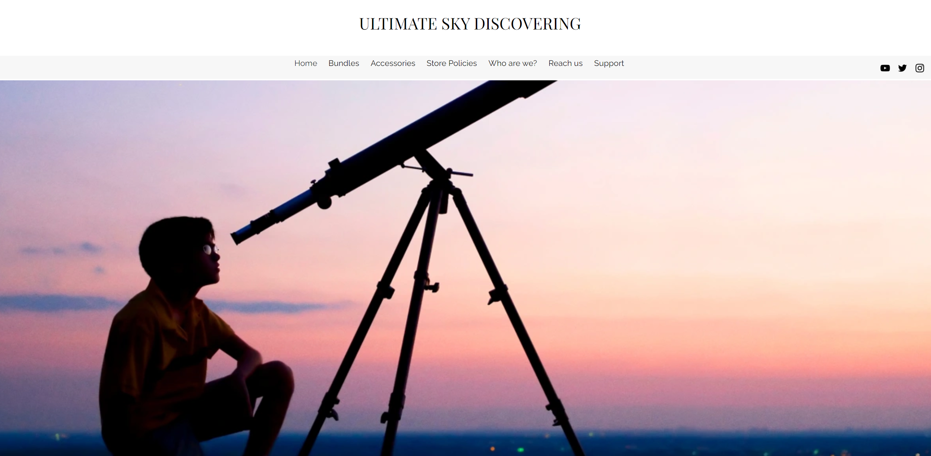
Store Overview
Bright Star

Slide 7
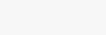
Store Overview
Bright Star

Slide 8
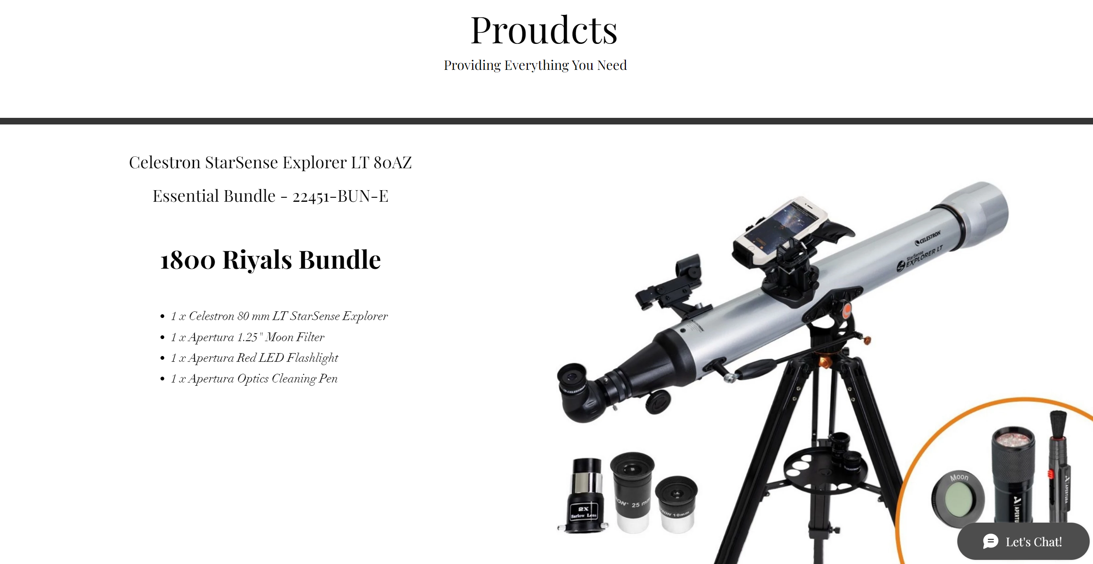
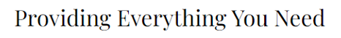
Store Overview

Slide 9
Store Overview
Bright Star

Slide 10
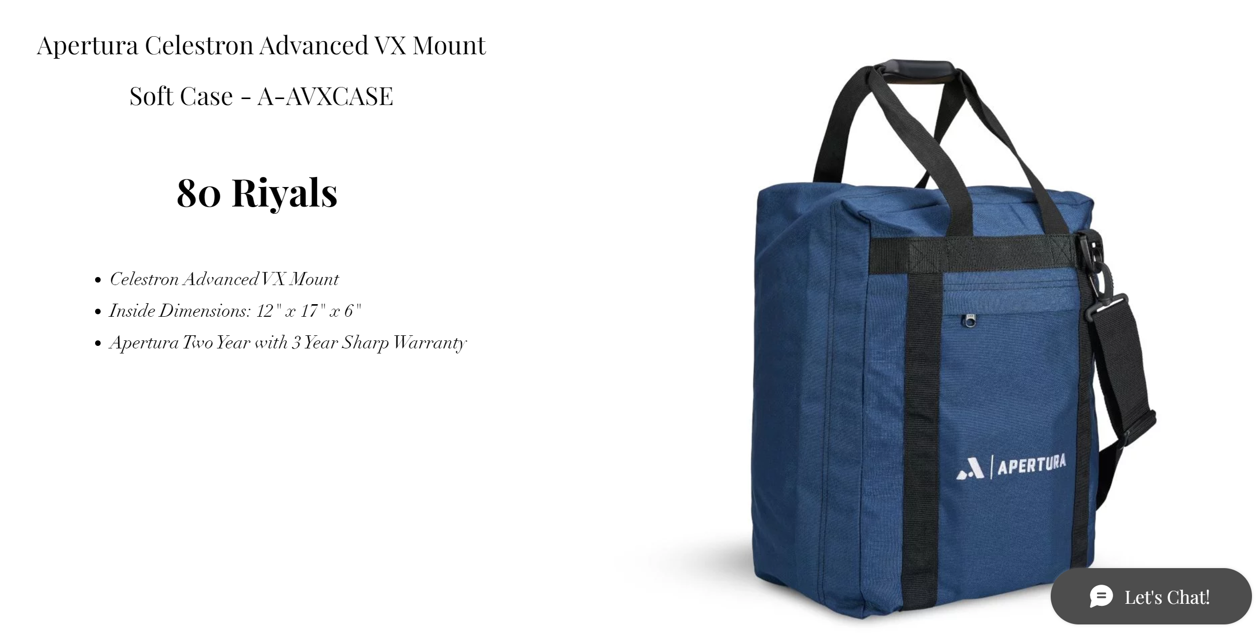
Store Overview

Slide 11
Store Overview
Bright Star

Slide 12



Store Overview
Bright Star
We will also add “astronomical calendar” tab to attract interested enthusiasits into visiting our website, who happens to be our target market, hence this feature acts as a marketing tool.
Also, we’ll add “events” tab to inform users about upcoming gatherings to observe astronomical events.
Our website will allow users to sign-up and sign-in, allowing them to use their accounts in registering for events or request buying a bundle or accessory.

Slide 13
Target market
Market value for telescopes and its accessories in Saudi Arabia is estimated to exceed 6 million
University students in Saudi Arabia exceed 1 million
Average age in Saudi Arabia is 31.8 years

Slide 14
Business model – Revenue streams
Initially, bundles and accessories sales
Later on, commissions on sales from manufacturers
12-18 months to break-even

Slide 15
Business model – Expected Revenue

Slide 16
Financial plan
50K- Family loans
125K – Initial budget
50K – Self fund
25K- Venture investment

Slide 17
30K - Technical development
125K – Initial budget
80K - Marketing
15K- Free cash

Slide 18



Reach us
zzyyxx321.wixsite.com/ultimate-sky-discove
@ Bright_Star
@ BrightStar
Bright Star™
+ 966 - 504434783

Slide 19

You’re welcome to
Ask

